Slide 1
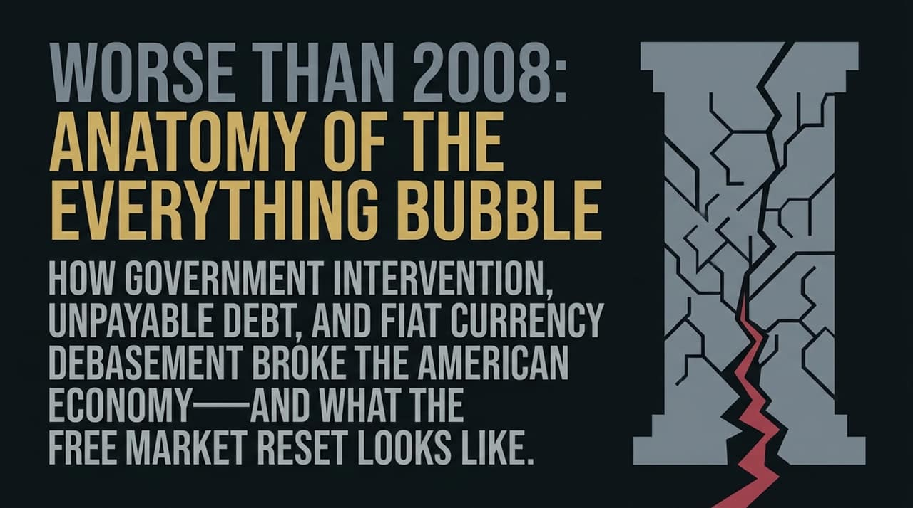
Notes:
Welcome, everyone. Today, we are taking a deep diagnostic look into the structural fragile points of the global economy. The core thesis of this talk is straightforward yet alarming: the financial crisis we are currently approaching is fundamentally far more dangerous than the Great Financial Crisis of 2008. In 2008, the crisis was predominantly localized within subprime mortgages, housing markets, and bad private banking leverage. Today, decades of artificial zero-percent interest rates, unchecked deficit spending, and continuous fiat currency debasement have inflated every single asset class simultaneously—creating what we call the "Everything Bubble". Over the next several slides, we will break down how government intervention broke economic fundamentals, why central banks are completely trapped, and what a necessary free-market reset looks like.
https://www.youtube.com/watch?v=wK9bX1Yast0

Slide 2
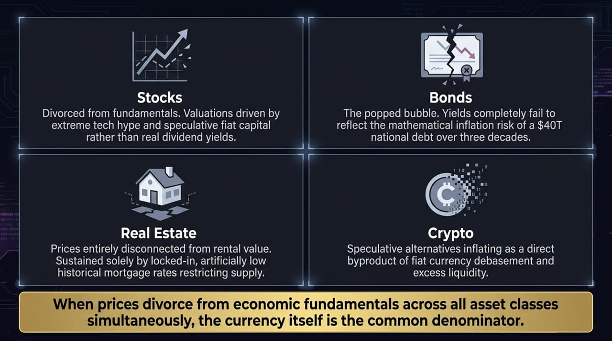
Notes:
When you look at modern capital markets, you see asset valuations detached from economic fundamentals across four primary pillars:
Stocks: Equity valuations are no longer anchored to underlying dividend yields or real earnings productivity. Instead, they are propelled by speculative fiat capital flows and intense tech hype.
Bonds: Bond yields completely fail to compensate investors for the real risk of inflation and currency dilution, especially with a US national debt pushing $40 trillion.
Real Estate: Housing prices have surged to historic highs relative to median incomes and real rental yields, sustained artificially by locked-in low mortgage rates from years past that restrict housing supply.
Crypto: Speculative digital assets serve as a direct symptom and byproduct of excess fiat liquidity spilling out of traditional finance in search of yields or inflation hedges.
When prices across equities, fixed income, housing, and alternative assets divorce from reality simultaneously, the issue isn't isolated within a single sector—the currency itself is the common denominator.

Slide 3
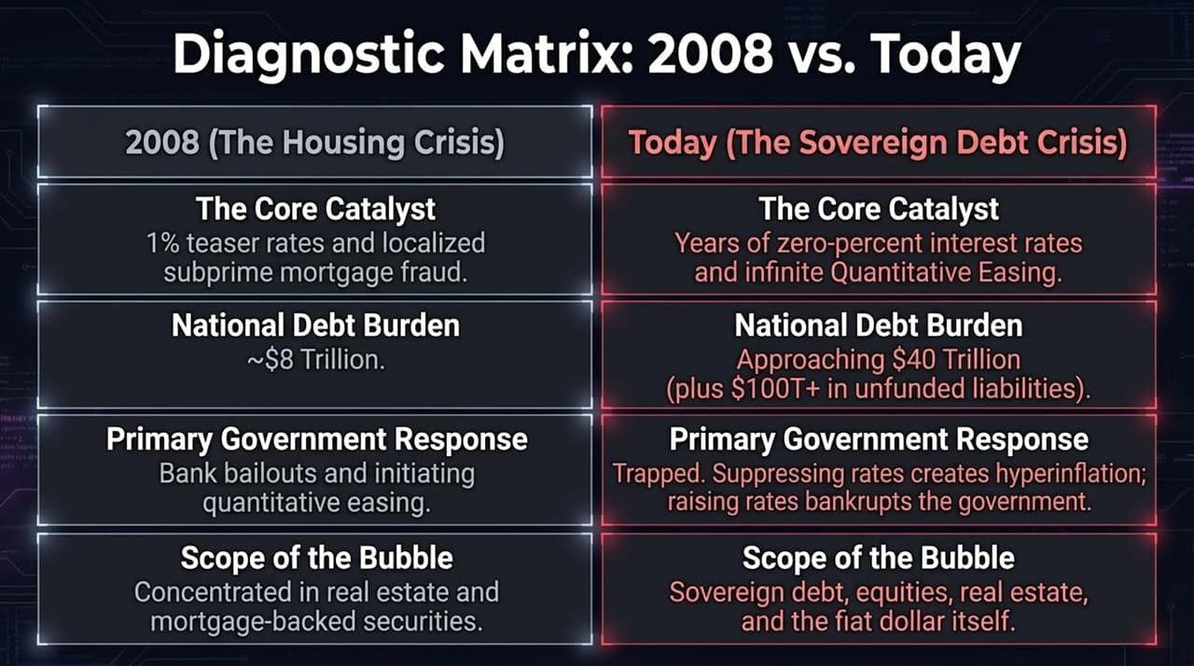
Notes:
To understand why the upcoming reckoning is so severe, let's contrast the 2008 crisis with our present landscape:
The Core Catalyst: In 2008, the catalyst was ~1% teaser mortgage rates and subprime mortgage fraud. Today, it is over a decade of Zero Interest Rate Policy (ZIRP) and infinite Quantitative Easing (QE).
National Debt Burden: In 2008, the US national debt sat at around $8 trillion. Today, it is approaching $40 trillion—not including over $100 trillion in unfunded entitlement liabilities.
Government Policy Options: In 2008, central banks could print money, slash interest rates, and bail out private banks. Today, central planners are completely trapped. If they keep interest rates low to service the national debt, they fuel runaway inflation. If they raise rates to curb inflation, they bankrupt the sovereign state.
Bubble Scope: 2008 was a real estate crisis. Today's bubble encompasses sovereign debt, corporate debt, real estate, stock markets, and the purchasing power of the fiat dollar itself.

Slide 4
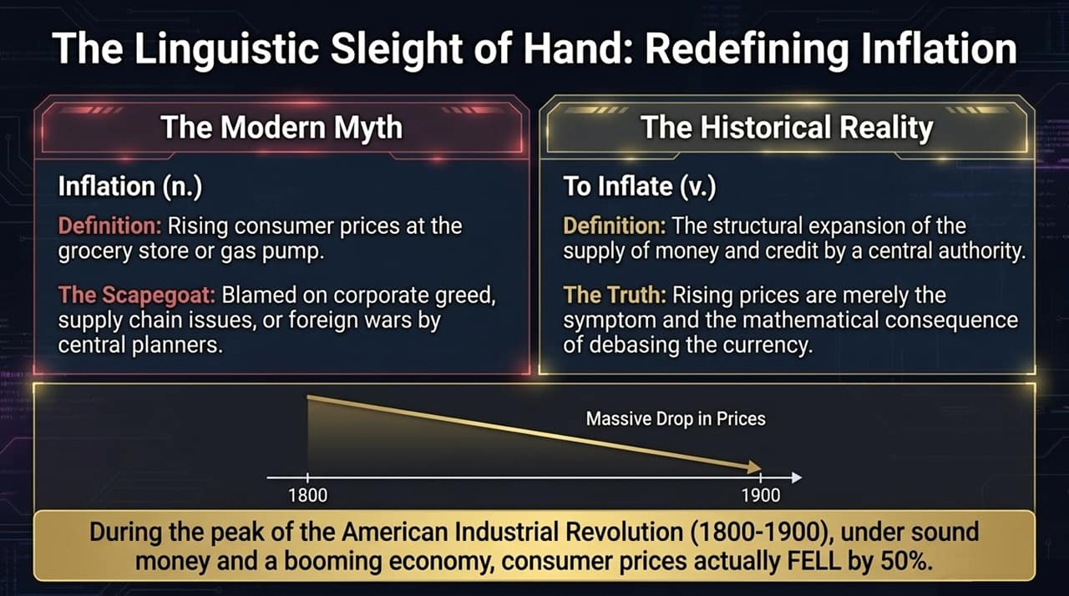
Notes:
To address economic crises effectively, we must cut through linguistic manipulations. Modern economic rhetoric defines inflation as simply "rising consumer prices at the grocery store or gas pump," attributing price increases to corporate greed, supply chain bottlenecks, or foreign conflicts.
However, looking at the classical definition, to inflate means to expand or pump up the supply of money and credit created by a central authority. Rising consumer prices are not inflation itself; they are merely the mathematical consequence and visible symptom of currency debasement.
Furthermore, historical evidence refutes the central bank narrative that mild inflation is necessary for economic growth. During the peak of the American Industrial Revolution (1800–1900), under a sound gold standard and expanding production, consumer prices actually fell by roughly 50% while real wages and standards of living rose steadily.

Slide 5
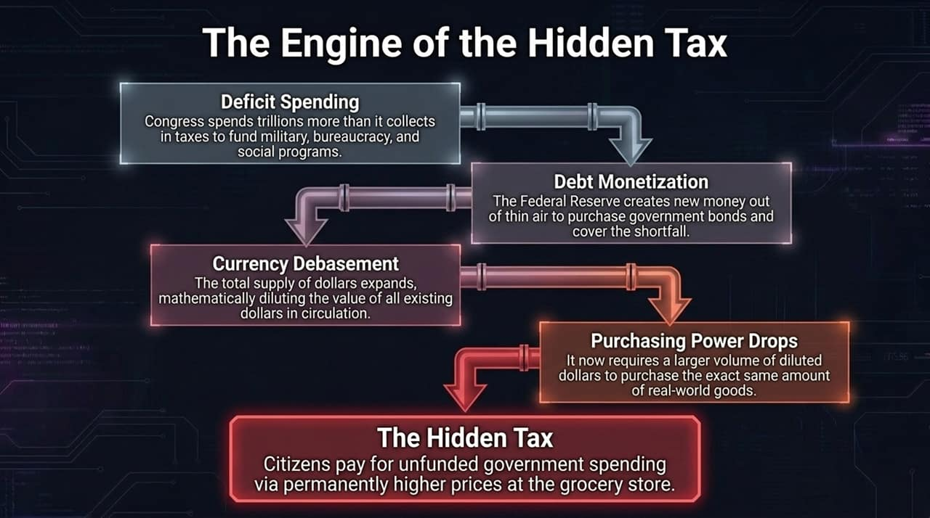
Notes:
How does currency debasement transfer wealth from citizens to the state? Through the mechanism of a hidden tax:
Deficit Spending: Congress routinely spends trillions of dollars more than it collects in tax revenue to fund expanding bureaucracies, military ventures, and entitlement programs.
Debt Monetization: To cover this deficit, the Federal Reserve creates new dollars out of thin air to buy government debt obligations (Treasuries).
Currency Debasement: This rapid expansion of the broad M2 money supply dilutes the value of every existing dollar held in savings or earned via wages.
Dropping Purchasing Power: As diluted dollars chase goods and services, prices rise at the checkout counter. Inflation acts as an unlegislated tax that imperceptibly confiscates real purchasing power from savers and workers to finance unbudgeted government expenditures.

Slide 6
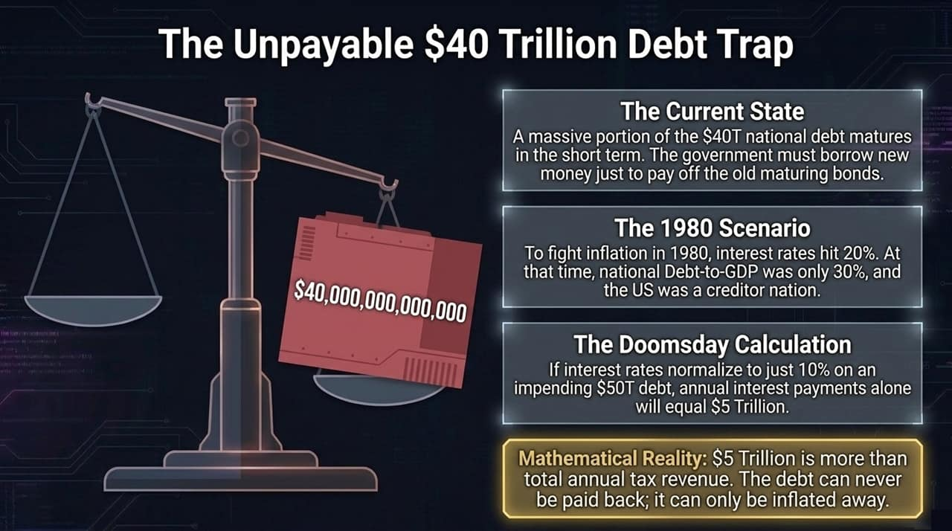
Notes:
We are fast approaching a mathematical wall regarding government solvency. Much of the current $40 trillion national debt is short-term and continuously rolls over. As old bonds mature, the government must issue new bonds at prevailing interest rates just to pay off old principal.
Contrast this with 1980: when Paul Volcker raised interest rates to 20% to break double-digit inflation, US Debt-to-GDP was only ~30%, and America was the world’s largest creditor nation.
Today, US Debt-to-GDP exceeds 120%. If interest rates were forced to normalize to even 10% on an impending $50 trillion debt load, annual interest expense alone would top $5 trillion—which exceeds total annual federal tax revenue. Mathematically, this debt cannot be paid back through productive taxation; it can only be defaulted on or inflated away via aggressive currency printing.

Slide 7
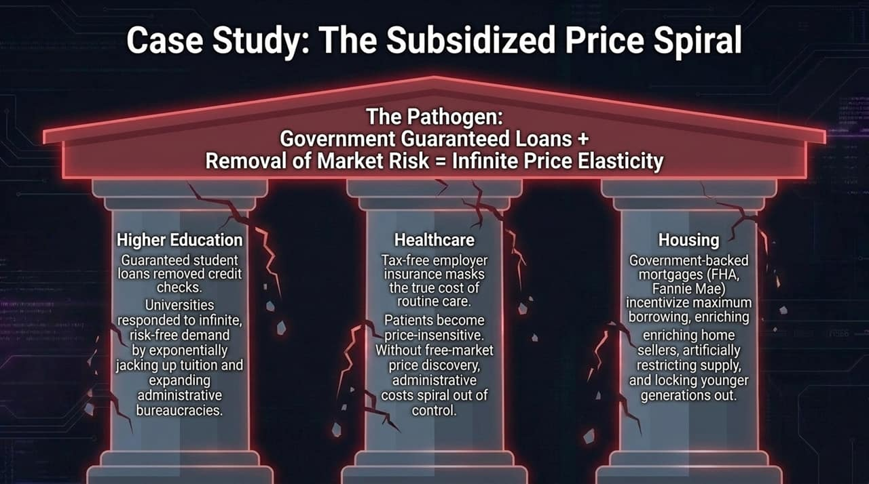
Notes:
Whenever the state intervenes to "make things affordable" through subsidies or guaranteed loans, it removes market risk and creates infinite price elasticity. We see this pathogen across three critical sectors:
Higher Education: Federal backing of student loans eliminated credit checks for colleges. Universities responded to guaranteed demand by inflating tuition rates exponentially and building out massive administrative bureaucracies.
Healthcare: Tax-free employer health plans and government insurance mandates mask the true cost of care. Unaware of real price discovery, patients become price-insensitive, driving administrative overhead sky-high.
Housing: Government-backed agencies (FHA, Fannie Mae, Freddie Mac) incentivize maximum leverage, pushing up home purchase prices, locking younger demographics out of homeownership, and creating persistent asset inflation

Slide 8
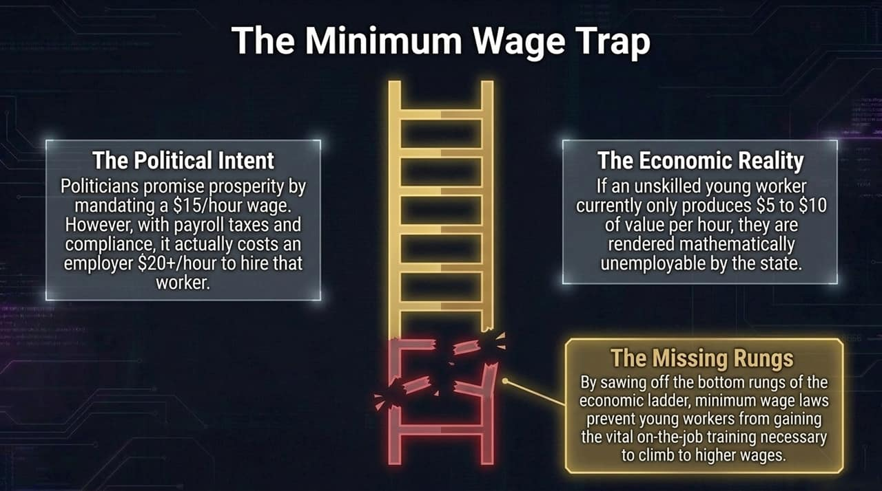
Notes:
Government mandates intended to help lower-income workers often achieve the exact opposite due to basic economic laws.
Politicians promise prosperity by mandating $15 or $20 minimum hourly wages. However, when accounting for mandatory payroll taxes, worker's compensation, and regulatory compliance, a mandated $15/hour wage actually costs an employer upwards of $20+ per hour in real terms.
If an entry-level worker generates $8 to $10 of economic value per hour while learning job skills, state mandates render them legally unemployable. By sawing off the bottom rungs of the economic ladder, price floors prevent young workers from getting entry-level experience and gaining skills needed to climb to higher earning tiers.

Slide 9
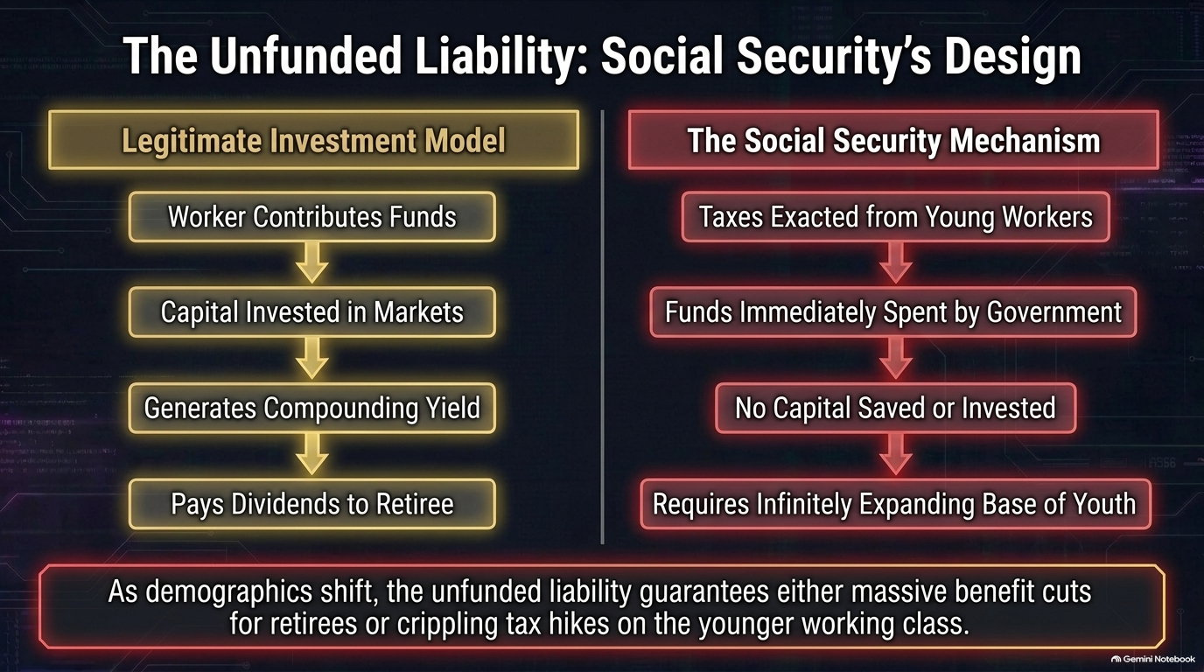
Notes:
To evaluate national balance sheets accurately, we must examine the structure of major government entitlement programs like Social Security.
In a legitimate investment model, a worker contributes capital that is saved, invested in real wealth-producing market assets, yields compounding returns, and pays out dividends upon retirement.
Social Security operates on a pay-as-you-go transfer system. Payroll taxes collected from current young workers are immediately spent by Congress on current government operations. No capital is saved or invested in real assets. The program relies on a perpetually growing base of young workers relative to retirees. As demographics shift toward an aging population, unfunded liabilities (estimated over $100 trillion) force a choice between severe benefit cuts for retirees or heavy tax increases on working generations.

Slide 10
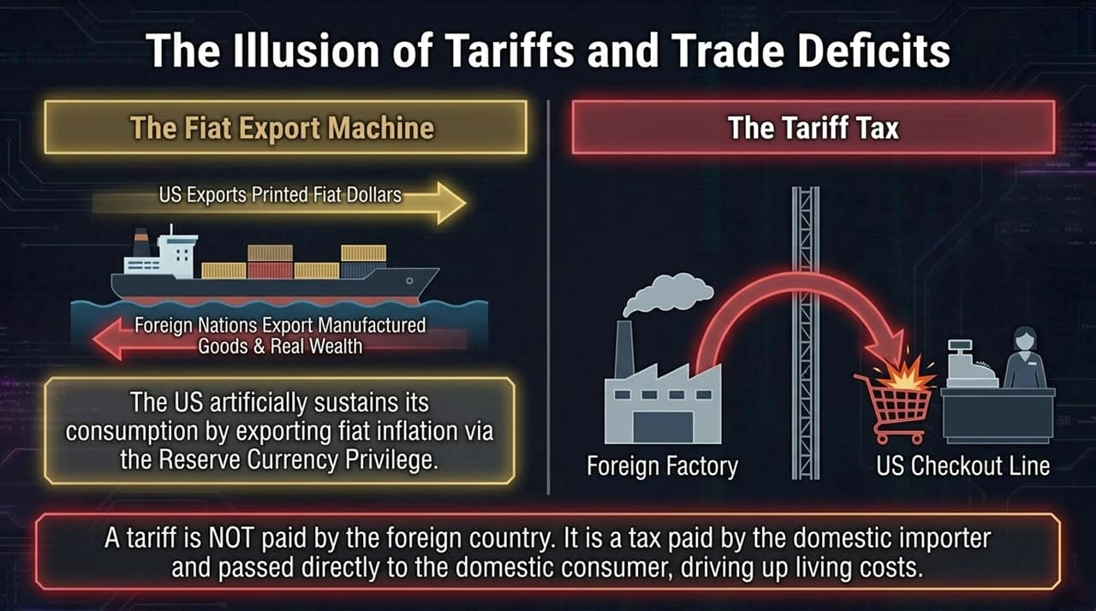
Notes:
Trade policy is another area ripe with economic misconceptions. Under global reserve currency arrangements, the US has maintained an artificial trade advantage: exporting paper dollars created at near-zero marginal cost in exchange for physical goods, appliances, cars, and raw resources produced overseas.
When governments impose tariffs under the promise of forcing foreign nations to pay, basic trade mechanics are misrepresented. A tariff is not paid by foreign factories; it is an import tax paid at customs by domestic importing businesses and passed directly to domestic consumers at checkout. Raising tariffs on imported goods increases consumer prices internally without fixing the core issue of domestic monetary inflation.

Slide 11
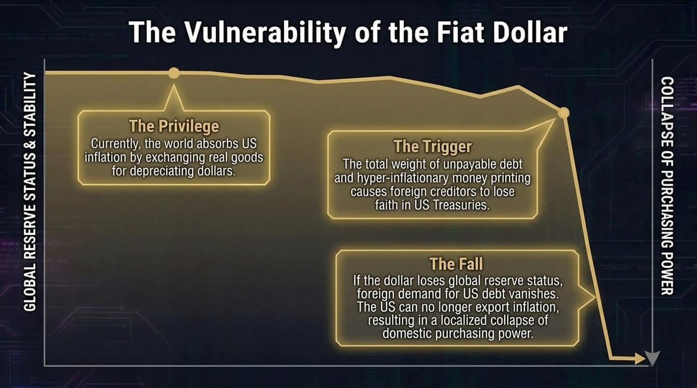
Notes:
The dollar’s global reserve currency status gives the US a structural privilege: the ability to export domestic monetary inflation abroad as foreign nations accumulate US Treasury reserves.
However, this dynamic holds only as long as global counterparties maintain trust in US fiscal management. As total national debt expands toward unsustainable levels and debt monetization accelerates, foreign central banks and foreign investors lose appetite for holding low-yielding, depreciating US debt instruments.
If global central banks reduce holdings of US Treasuries and de-dollarize trade settlements, the ability to export inflation diminishes. Offshore dollars risk returning to domestic markets, accelerating purchasing power loss at home.

Slide 12
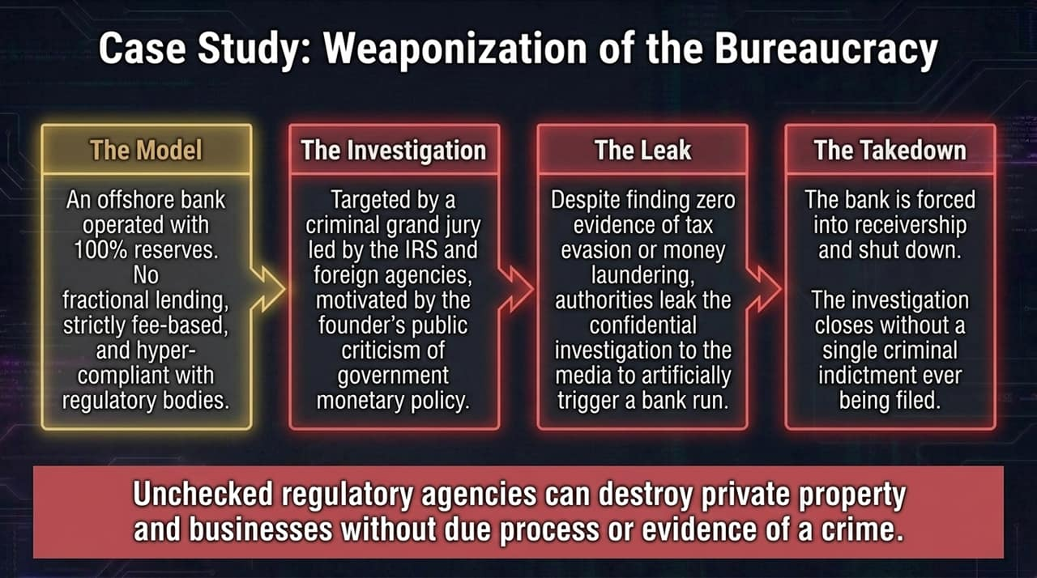
Notes:
As government budgets and federal agencies expand, regulatory power can easily be misused to target non-compliant or dissenting businesses.
Peter Schiff’s experience with Euro Pacific Bank serves as a notable case study in administrative overreach. Euro Pacific Bank operated as a 100% full-reserve offshore financial institution—it engaged in no fractional-reserve lending, operated strictly on fee-for-service models, and maintained compliance records.
Despite a multi-year joint international tax investigation finding zero evidence of money laundering or tax evasion, coordinated regulatory actions and unproven media leaks caused liquidity runs that forced the bank into receivership and shutdown. The operation concluded without formal criminal charges or indictments against the bank, demonstrating how administrative overreach can damage private enterprises without standard due process.

Slide 13
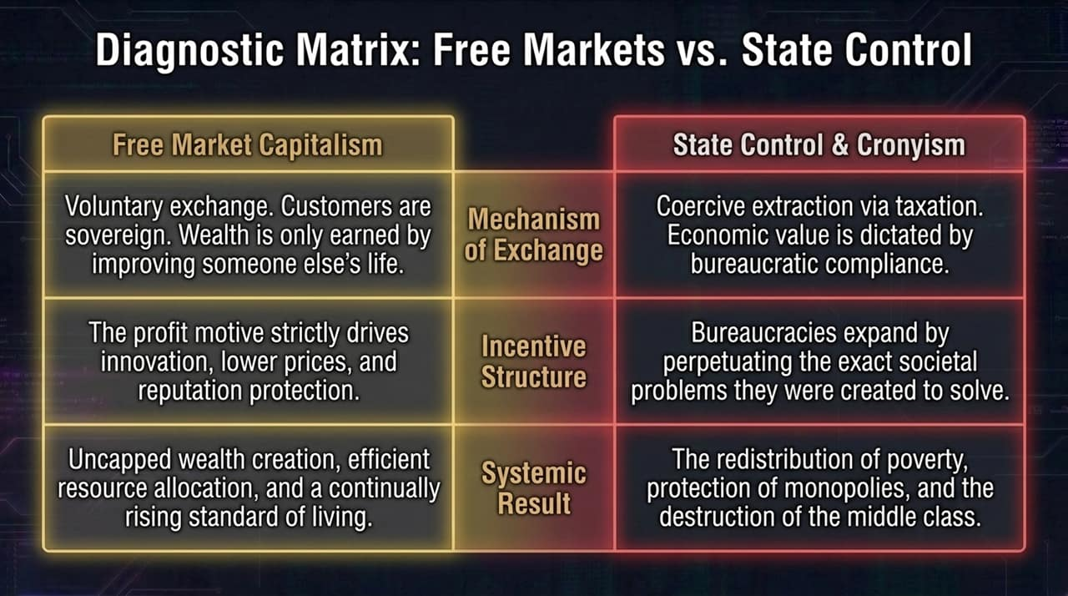
Notes:
Comparing pure free-market dynamics with expanded state control highlights fundamental structural differences:
Mechanism of Exchange: Free markets rely on voluntary exchanges where wealth is earned by offering value to others. State control relies on coercive tax extraction and bureaucratic regulation.
Incentive Structures: In free markets, profit motives and competition drive innovation, efficiency, and lower costs. Public bureaucracies tend to expand their budgets and authority by perpetuating the problems they were created to address.
Systemic Results: Unfettered capital allocation encourages wealth creation, higher productivity, and rising living standards. Over-regulation and government intervention distort price signals, reduce real productivity, and strain the middle class.

Slide 14
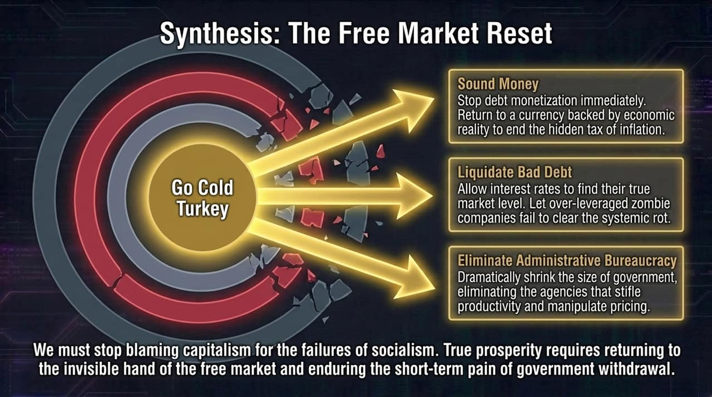
Notes:
To recover real economic stability, short-term fixes won't suffice—a structural reset is necessary.
Adopt Sound Money: End debt monetization by central banks. Restrict currency creation to anchor economic activity to real production rather than inflationary debt expansions.
Allow Bad Debt Liquidation: Permit interest rates to reach natural market-clearing levels. Over-leveraged, unproductive "zombie" corporations should restructure or fail, clearing room for efficient capital allocation.
Dismantle Excess Administrative Bureaucracy: Significantly reduce the size, scope, and spending of federal regulatory agencies to lower costs, foster competition, and restore price discovery.
True prosperity requires moving away from continuous intervention and allowing free-market principles to function.

Slide 15
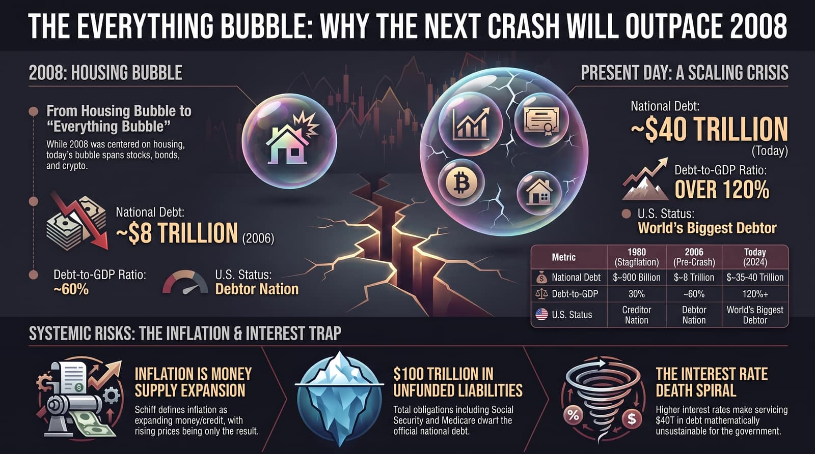
Notes:
In 2006, national debt was $8 trillion, Debt-to-GDP sat near 60%, and the US was a debtor nation with manageable interest burdens. Today, national debt approaches $40 trillion, Debt-to-GDP exceeds 120%, and official unfunded liabilities top $100 trillion.
We face a critical structural dilemma: Inflation stems from rapid money supply growth. To curb inflation, interest rates must rise, but higher interest rates drastically increase the cost of servicing $40 trillion in public debt. This dynamic leaves central planners trapped between sovereign default and accelerating inflation.
Navigating this environment requires understanding these underlying monetary mechanics, prioritizing real capital protection, and preparing for a transition back toward sound economic fundamentals.

